Slide 1
Rule-based Systems
John Platt

Slide 2
KBS architecture

Slide 3
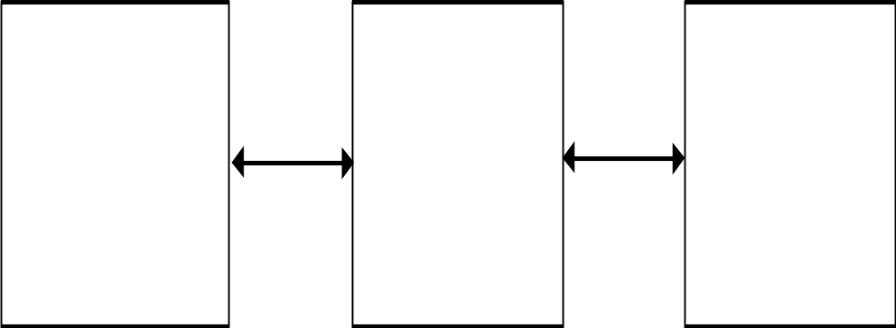
KBS architecture (1)
The typical architecture of an KBS is often described as follows:
user
interface
user
inference
engine
knowledge
base

Slide 4
KBS architecture (1)
The inference engine and knowledge base are separated because:
  the reasoning mechanism needs to be as stable as possible;
  the knowledge base must be able to grow and change, as knowledge is added;
  this arrangement enables the system to be built from, or converted to, a shell.

Slide 5
KBS architecture (2)
It is reasonable to produce a richer, more elaborate, description of the typical KBS.
A more elaborate description, which still includes the components that are to be found in almost any real-world system, would look like this:

Slide 6
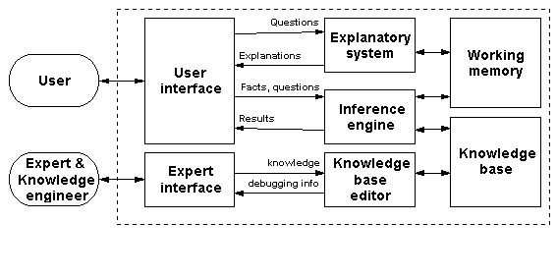
KBS architecture (2)

Slide 7
KBS architecture (2)

Slide 8
KBS architecture (2)
  The system holds a collection of general principles which can potentially be applied to any problem - these are stored in the knowledge base.
  The system also holds a collection of specific details that apply to the current problem (including details of how the current reasoning process is progressing) - these are held in working memory.
  Both these sorts of information are processed by the inference engine.

Slide 9
KBS architecture (2)

Slide 10
KBS architecture (2)
Any practical expert system needs an explanatory facility. It is essential that an expert system should be able to explain its reasoning. This is because:

Slide 11
it gives the user confidence in the system;

Slide 12
it makes it easier to debug the system.

Slide 13
KBS architecture (2)

Slide 14
KBS architecture (2)
It is not unreasonable to include an expert interface & a knowledge base editor, since any practical KBS is going to need a mechanism for efficiently building and modifying the knowledge base.

Slide 15
KBS architecture (2)

Slide 16
As mentioned earlier, a reliable expert should be able to explain and justify his/her advice and actions.

Slide 17
Rule-based reasoning

Slide 18
Rule-based reasoning
One can often represent the expertise that someone uses to do an expert task as rules.
A rule means a structure which has an if component and a then component.
This is actually a very old idea indeed -

Slide 19
The Edwin Smith papyrus
The Edwin Smith papyrus is a 3700-year-old ancient Egyptian text.
ABCDEECDBBACDACDBCDECDADCADBADE
ECDBBACDACDBCDECDADCADBADCDBBACDA
BCDEECDBBACDACDBCDECDAD
BBACDACDBCDECDADCADBADEDCDBBA
DCDBBADCDBBABCDECDADCADBADEACDA
BACDACDBCDECDADBACDACDBCDECDAD

Slide 20
The Edwin Smith papyrus
It contains medical descriptions of 48 different types of head wound.
There is a fixed format for each problem description: Title - symptoms - diagnosis - prognosis - treatment.

Slide 21
The Edwin Smith papyrus
There's a fixed style for the parts of each problem description. Thus, the prognosis always reads "It is an injury that I will cure", or "It is an injury that I will combat", or "It is an injury against which I am powerless".
An example taken from the Edwin Smith papyrus:

Slide 22
The Edwin Smith papyrus
Title:
Instructions for treating a fracture of the cheekbone.
Symptoms:
If you examine a man with a fracture of the cheekbone, you will find a salient and red fluxion, bordering the wound.

Slide 23
The Edwin Smith papyrus
Diagnosis and prognosis:
Then you will tell your patient: "A fracture of the cheekbone. It is an injury that I will cure."
Treatment:
You shall tend him with fresh meat the first day. The treatment shall last until the fluxion resorbs. Next you shall treat him with raspberry, honey, and bandages to be renewed each day, until he is cured.

Slide 24
Rule-based reasoning: rules
examples:
if - the leaves are dry, brittle and discoloured
then - the plant has been attacked by red spider mite
if - the customer closes the account
then - delete the customer from the database

Slide 25
Rule-based reasoning: rules
The statement, or set of statements, after the word if represents some pattern which you may observe.
The statement, or set of statements, after the word then represents some conclusion that you can draw, or some action that you should take.

Slide 26
Rule-based reasoning: rules
A rule-based system, therefore, either
  identifies a pattern and draws conclusions about what it means,
  or
  identifies a pattern and advises what should be done about it,
  or
  identifies a pattern and takes appropriate action.

Slide 27
Rule-based reasoning: rules
  The essence of a rule-based reasoning system is that it goes through a series of cycles.
  In each cycle, it attempts to pick an appropriate rule from its collection of rules, depending on the present circumstances, and to use it as described above.
  Because using a rule produces new information, it's possible for each new cycle to take the reasoning process further than the cycle before. This is rather like a human following a chain of ideas in order to come to a conclusion.

Slide 28
Terminology
A rule as described above is often referred to as a production rule.
A set of production rules, together with software that can reason with them, is known as a production system.

Slide 29
Terminology
There are several different terms for the statements that come after the word if, and those that come after the word then.
  The statements after if may be called the conditions, those after then may be called the conclusions.
  The statements after if may be called the premises, those after then may be called the actions.
  The statements after if may be called the antecedents, those after then may be called the consequents.

Slide 30
Terminology
  Some writers just talk about the if-part and the then-part.

Slide 31
Terminology
If a production system chooses a particular rule, because the conditions match the current state of affairs, and puts the conclusions into effect, this is known as firing the rule.

Slide 32
Terminology
In a production system, the rules are stored together, in an area called the rulebase.

Slide 33
Historical note
Mathematicians, linguists, psychologists and artificial intelligence specialists explored the possibilities of production rules during the 40s, 50s and 60s.
When the first expert systems were invented in the 70s, it seemed natural to use production rules as the knowledge representation formalism for the knowledge base.

Slide 34
Historical note
Production rules have remained the most popular form of knowledge representation for expert systems ever since.

Slide 35
Conditional branching
Is a production rule the same as a conditional branching statement?
A production rule looks similar to the
if (statement to be evaluated) then (action) pattern which is a familiar feature of all conventional programming languages.

Slide 36
Conditional branching
e.g. The following fragment from a C program:

Slide 37
Conditional branching
{ int magic;
int guess;
magic = rand( );
printf(“guess the magic number: ”);
scanf(“%d”, &guess);
if (guess == magic) printf(“** Right **”);
else {
printf(“Wrong, ”);
if (guess > magic) printf(“too high”);
else printf(“too low”);
}
}

Slide 38
Conditional branching vs. production rules
However, the similarity is misleading. There is a radical difference between a production system and a piece of conventional software.
  In a conventional program, the if...then... structure is an integral part of the code, and represents a point where the execution can branch in one of two (or more) directions.

Slide 39
Conditional branching vs. production rules
  In a production system, the if...then... rules are gathered together in a rule base, and the controlling part of the system has some way of choosing a rule from this knowledge base which is appropriate to the current circumstances, and then using it.

Slide 40
Reasoning with production rules
The statements forming the conditions, or the conclusions, in such rules, may be structures, following some syntactic convention (such as three items enclosed in brackets).

Slide 41
Reasoning with production rules
Very often, these structures will include variables - such variables can, of course, be given a particular value, and variables with the same name in the same rule will share the same value.

Slide 42
Reasoning with production rules
For example (assuming words beginning with capital letters are variables, and other words are constants):
if [Person, age, Number] &
[Person, employment, none] &
[Number, greater_than, 18] &
[Number, less_than, 65]
then [Person, can_claim,
unemployment_benefit].

Slide 43
Reasoning with production rules
Architecture of a typical production system:
observed data
working memory
select
modify
rule memory
Inference
engine
fire
output

Slide 44
Reasoning with production rules
Architecture of a typical production system:
New information
working memory
select
modify
rule memory
interpreter
fire
output

Slide 45
Reasoning with production rules
Architecture of a typical production system:
New information
select
working memory
modify
rule memory
interpreter
fire
output

Slide 46
Reasoning with production rules
Architecture of a typical production system:
New information
working memory
select
modify
Inference
engine
executes
actions
rule memory
output
fire

Slide 47
Reasoning with production rules
Architecture of a typical production system:
New information
working memory
select
modify
Inference
engine
executes
actions
rule memory
fire
output

Slide 48
Reasoning with production rules
Architecture of a typical production system:
New information
select
working memory
modify
rule memory
interpreter
fire
output

Slide 49
Reasoning with production rules
Architecture of a typical production system:
New information
working memory
select
modify
Inference engine
executes
actions
rule memory
output
fire

Slide 50
Reasoning with production rules
Architecture of a typical production system:
New information
working memory
select
modify
Inference engine
executes
actions
rule memory
fire
output

Slide 51
Architecture of a typical production system
Has a working memory.
  Holds items of data. Their presence, or their absence, causes the inference engine to trigger certain rules.
  e.g. W.M. contains [john, age, 29] & [john, employment, none]
  The system decides: does this match any rules in the rulebase? If so, choose the rule.

Slide 52
Architecture of a typical production system
has an inference engine. Behaviour of the inference engine :
  the system is started by putting a suitable data item into working memory.
  recognise-act cycle: when data in the working memory matches the conditions of one of the rules in the system, the rule fires (i.e.is brought into action).

Slide 53
Advantages of production systems ... at first glance
The principle advantage of production rules is notational convenience - it’s easy to express suitable pieces of knowledge in this way.
The principle disadvantage of production rules is their restricted power of expression - many useful pieces of knowledge don’t fit this pattern.

Slide 54
Advantages of production systems ... at first glance
This would seem to be a purely declarative form of knowledge representation. One gathers pieces of knowledge about a particular subject, and puts them into a rulebase. One doesn't bother about when or how or in which sequence the rules are used; the production system can deal with that.
When one wishes to expand the knowledge, one just adds more rules at the end of the rulebase.

Slide 55
Advantages of production systems ... at first glance
The rules themselves are very easy to understand, and for someone (who is expert in the specific subject the system is concerned with) to criticise and improve.

Slide 56
Advantages of production systems ... at first glance
It's fairly straightforward to implement a production system interpreter. Following the development of the Rete Matching Algorithm, and other improvements, quite efficient interpreters are now available.

Slide 57
Advantages of production systems ... at first glance
However, it isn't that simple. See "advantages reconsidered" later on.

Slide 58
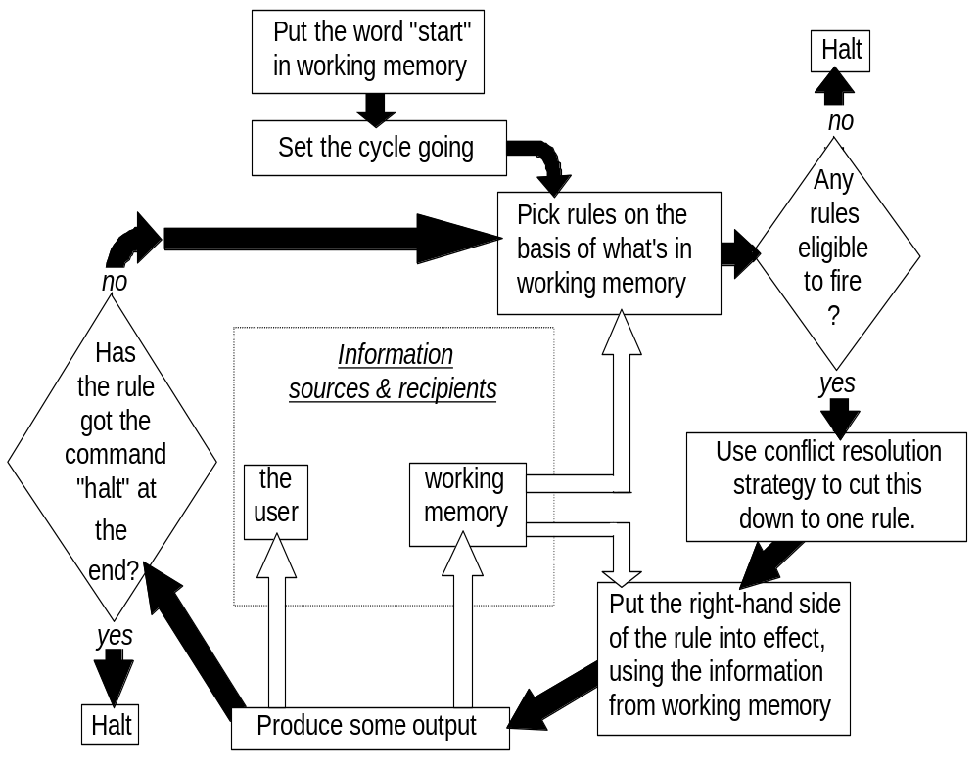
Operation of a production system in more detail
The recognise-act cycle (forward-chaining):

Slide 59

Operation of a production system in more detail
  The recognise-act cycle (forward-chaining):

Slide 60
Operation of a production system in more detail
  The recognise-act cycle (forward-chaining):

Slide 61
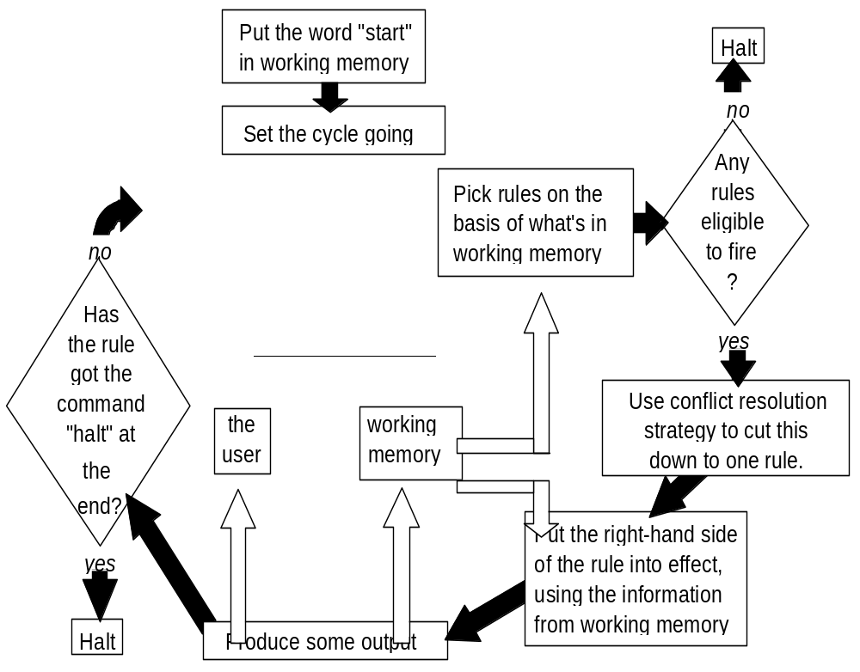
Operation of a production system in more detail
  The recognise-act cycle (forward-chaining):

Slide 62
Operation of a production system in more detail
  The recognise-act cycle (forward-chaining):

Slide 63
Operation of a production system in more detail
  The recognise-act cycle (forward-chaining):

Slide 64
Operation of a production system in more detail
  The recognise-act cycle (forward-chaining):

Slide 65
Operation of a production system in more detail
  The recognise-act cycle (forward-chaining):

Slide 66
The recognise-act cycle
N.B. "right-hand side of the rule" means the part after the word then.

Slide 67
The recognise-act cycle
conflict resolution strategy: if more than one rule matches working memory contents, this decides which one is to fire. Alternatively, the rule base could be designed so there's never any conflict (but usually isn't).

Slide 68
The recognise-act cycle
Applying the rule will probably modify the contents of working memory. Then the system continues with the recognise-act cycle.
The system stops when
  the rules stop firing, or
  a rule fires which specifically tells the system to halt.

Slide 69
Conflict resolution strategies
Choice of c.r.s. can make a big difference to system performance.
Three favourite strategies:
  Refractoriness: don't allow a rule to fire twice on same data.
  Recency: take the data which arrived in working memory most recently, and find a rule that uses this data.
  Specificity: use the most specific rule (the one with the most conditions attached).

Slide 70
Conflict resolution strategies
However, in recent years the fashion (in expert system shells) has been for very simple CRSs, coupled with a reluctance to mention the problem to the potential system builder.
Simple strategies:
  Give each rule a priority number. If a choice has to be made, choose the rule with the highest number.
  If a choice has to be made, choose the rule that comes first in the rule base.

Slide 71
Advantages of production systems reconsidered.
Because of the effect of conflict resolution strategies, rules interact and the order of rules matters.
  One must go beyond the declarative meaning of the rules and consider when (under which circumstances) they will fire.
  One cannot properly understand a rule simply by reading it in isolation; one must consider the related rules, the meta-rules, and the conflict resolution strategy as well.

Slide 72
Advantages of production systems reconsidered.
For the same reason, attempting to expand a production system by simply adding more rules at the end is dangerous.
  Unexpected rule interactions are liable to happen.
  The need to consider all these possible rule interactions makes large rule-based systems unwieldy and hard to update.

Slide 73
Advantages of production systems reconsidered.
Although non-computer-specialists find it easy to grasp the meaning of individual rules, they don't find it easy to grasp these issues concerned with interactions.

Slide 74
Advantages of production systems reconsidered.
Although efficient rule interpreters are available, one may still need to engage in meta-level programming in order to achieve a production system that shows acceptable performance on a large rulebase.

